Slide 1

Welcome to the CPL Live Scoring App
Live Scores at Your Fingertips
Stay in the Game with Real-time Updates
Effortlessly track scores, wickets, and match details in real-time. Filter scores by team or tournament for easy navigation.
Experience instant push notifications for every ball, run, and wicket. Data is directly sourced from official CPL feeds for accuracy.
Connect with the CPL Community
Engage with fellow fans through leaderboards, news, player profiles, and a social platform designed for interaction.

Slide 2
Introduction
Problem Statement
Solution
Manual scorekeeping was time-consuming and error-prone.
Three-tier system for seamless scoring.
Admin Panel (React): Web interface for score management.
Lack of centralized system caused delays and limited accessibility.
User Mobile App (Flutter): Live scores and match info for users.
Goal: Create a digital solution for efficient score management and sharing.
Backend Server (PHP with REST APIs): Data management and communication.

Slide 3
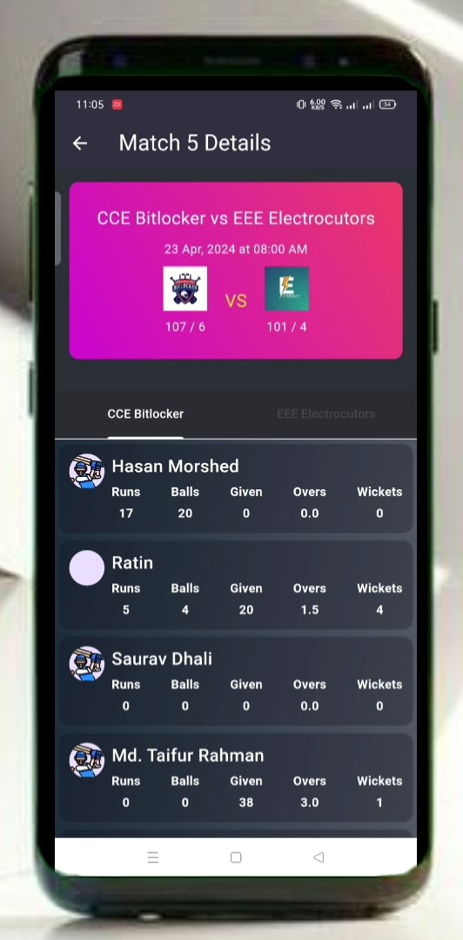
Project Objectives
1
Primary Objective
Real-time score management and data integrity.
2
Secondary Goals
Efficient data entry and management
Real-time information sharing
Enhanced user experience

Slide 4
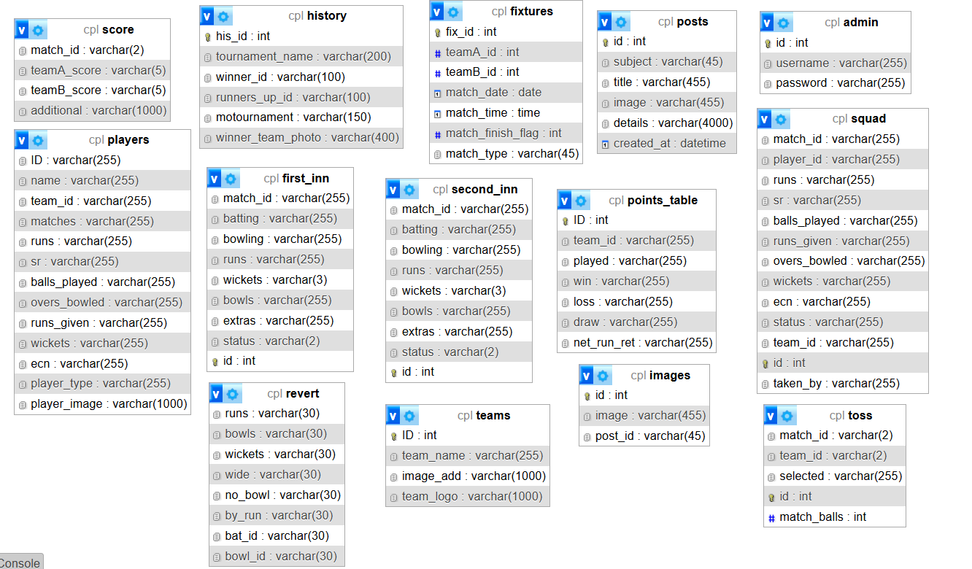
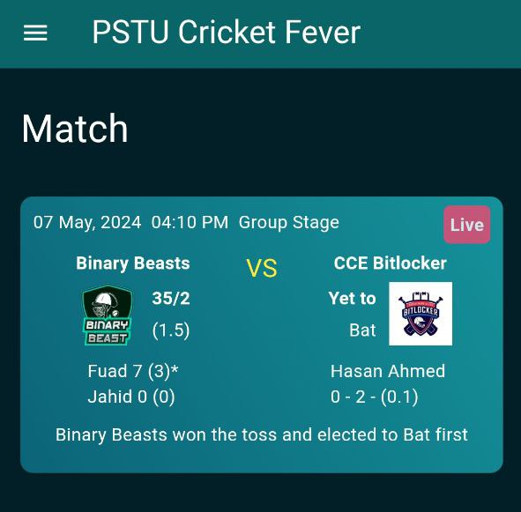
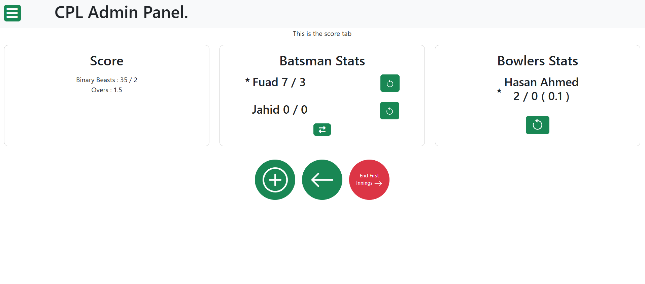
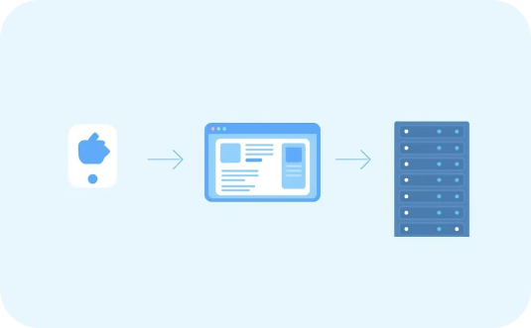
System Design And Architecture
Frontend Layer
Middleware/Backend Layer
Data Layer
React & Flutter interface for users and admins. Admin Panel (React) manages scores; User App (Flutter) shows live scores.
PHP REST APIs handle data processing and communication between frontend and database.
MySQL database stores match scores, team info, and player stats.

Slide 5





Technology Stack
React.js
Flutter
Chosen for building the Admin Panel, React.js provides a robust framework for developing dynamic and interactive user interfaces.
Used for developing the User Mobile Application, Flutter enables cross-platform compatibility, allowing the app to run seamlessly on both Android and iOS devices.
PHP
MySQL
The backend server is powered by PHP, which provides a versatile and efficient environment for developing RESTful APIs.
Used for relational data management, MySQL ensures reliable and consistent storage of match data, player information, and other relevant details.

Slide 6

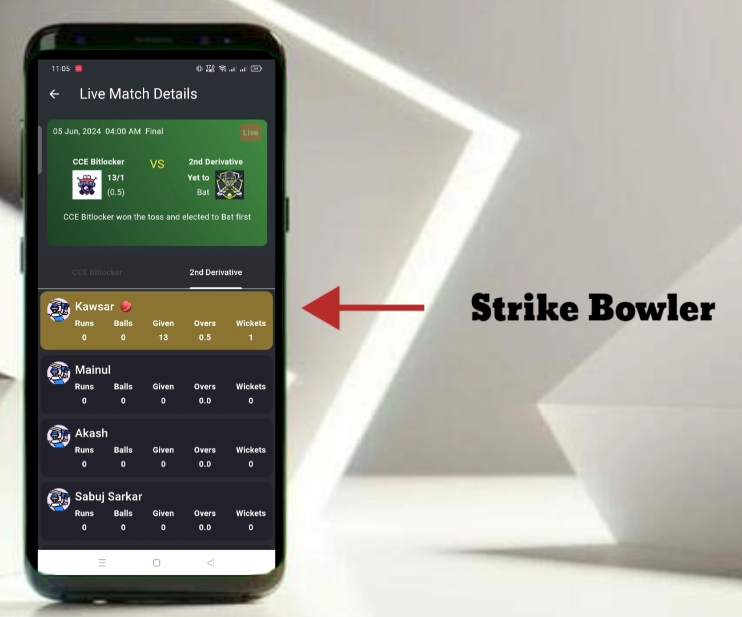
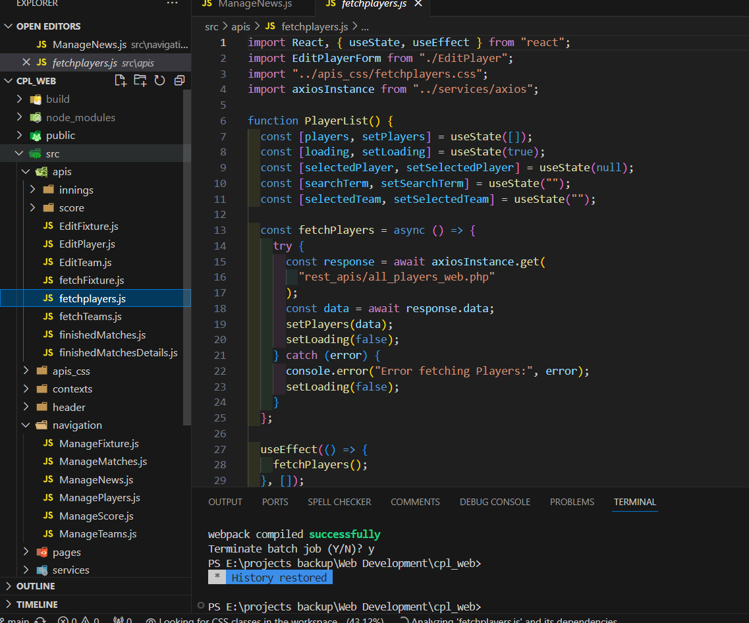
Detailed Component Analysis
Admin Panel (React)
User Mobile Application (Flutter)
Server-Side Backend (PHP with REST APIs)
Dashboard, Match Management, Real-time updates, Player/Team management.
Live scores, Match schedules, Team/Player profiles.
REST APIs, Authentication, Database management, Error handling.

Slide 7
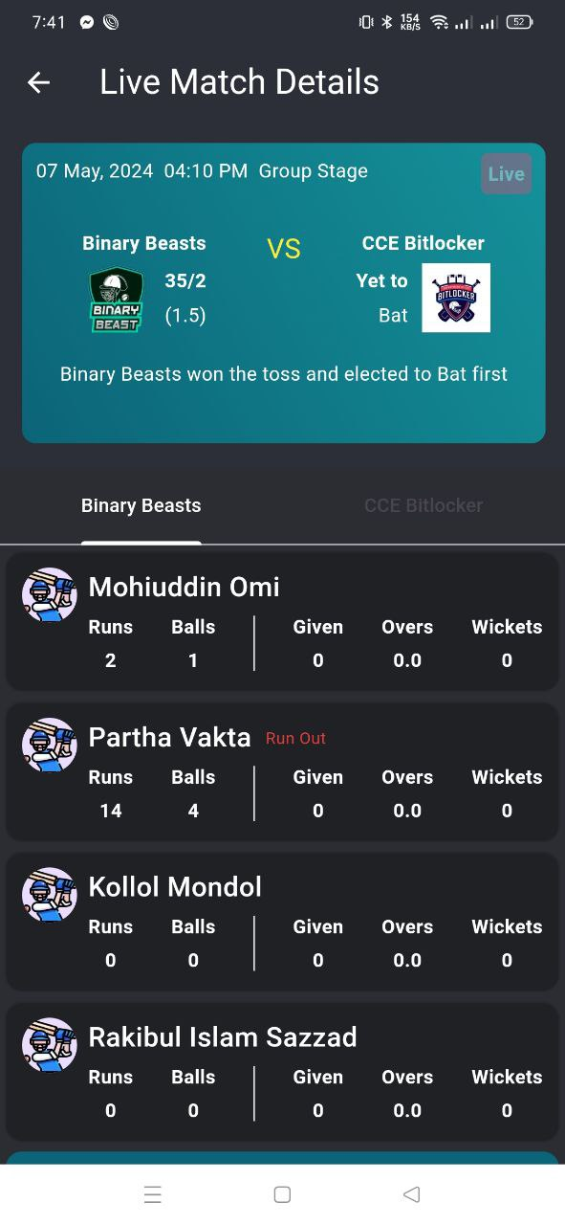
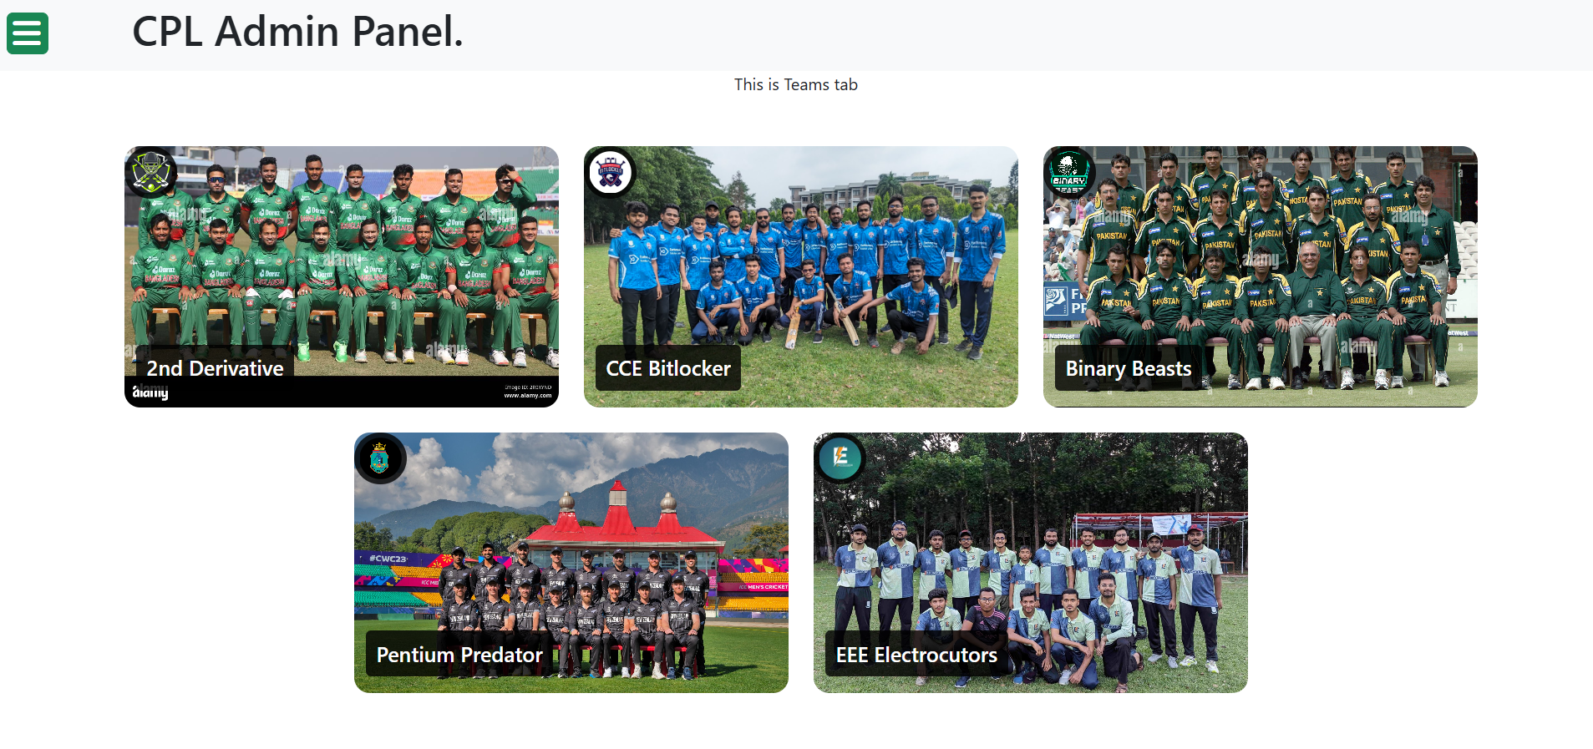
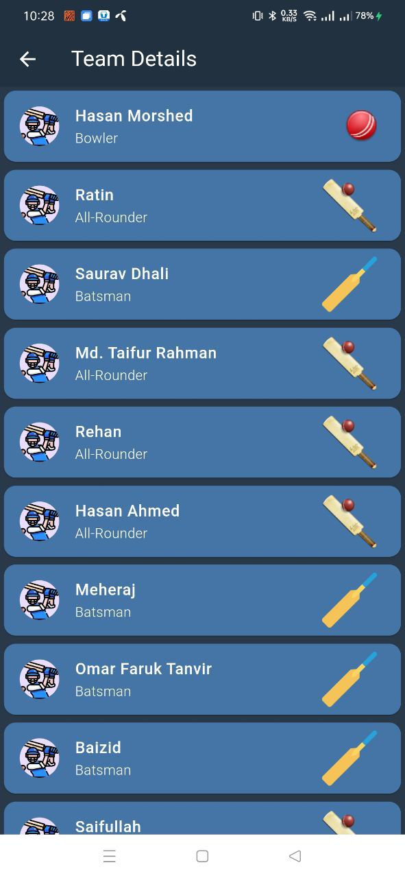
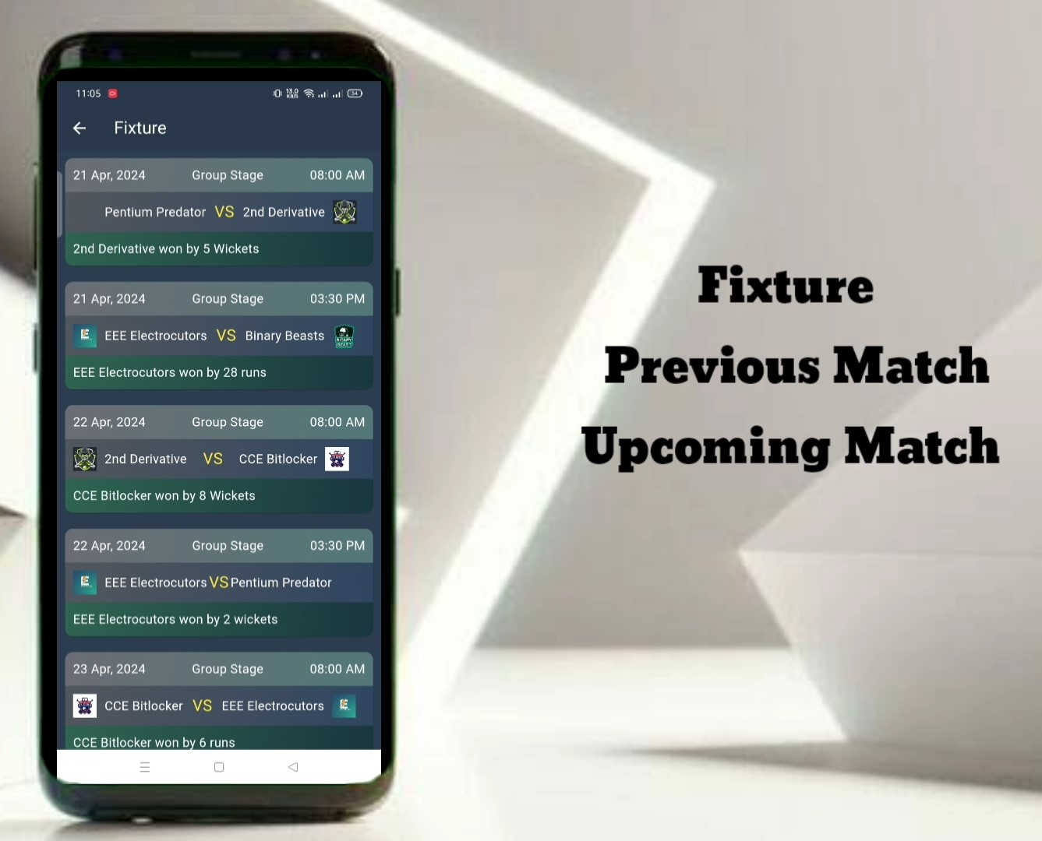
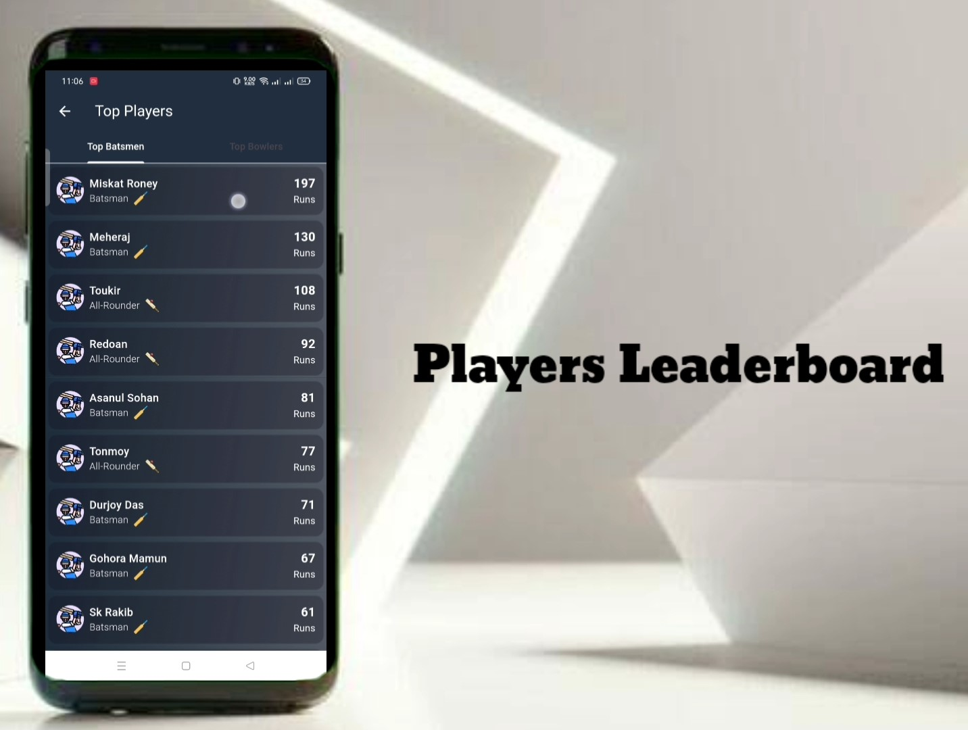
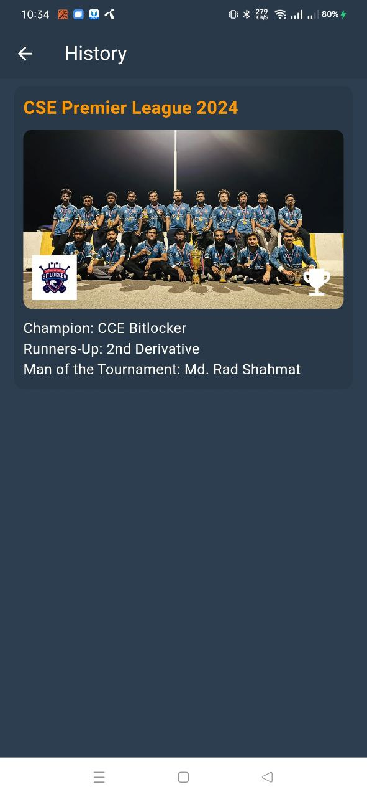
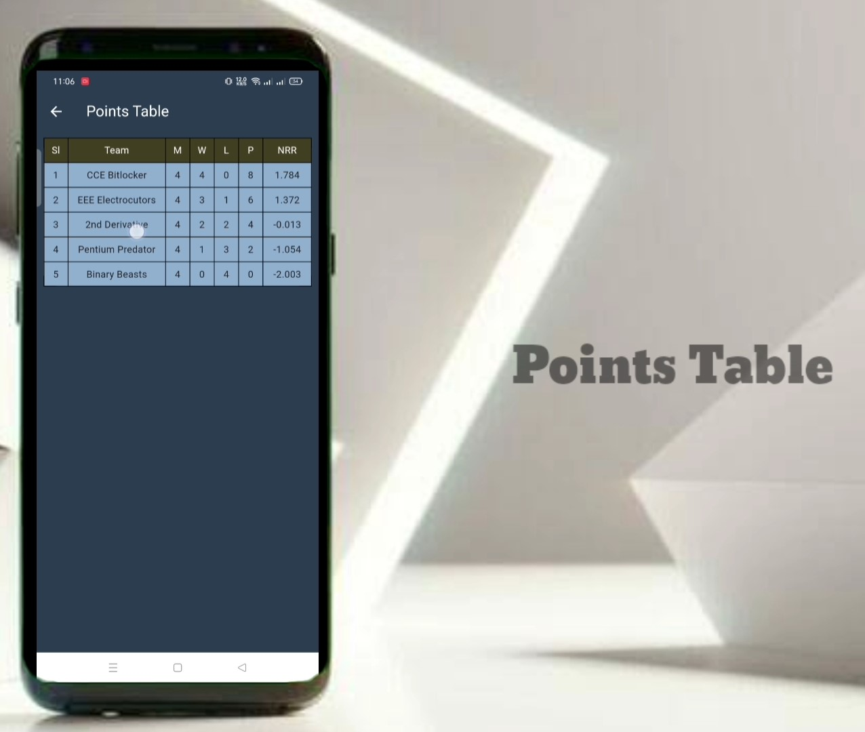
Core Functionalities And Features
Admin Score Management
Real-Time Data Synchronization
Player and Team Management
Live Score Display
Simplified score entry and management.
Real-time score updates for a seamless user experience.
Efficient management of player and team information.
Instant access to the latest scores for users.
Interactive Match Schedules
Leaderboard
Previous Season History
PointsTable
Easily accessible match schedules and progress tracking.
Real-time ranking of teams based on scores.
Access to data from previous seasons for comparison and analysis.
Automatic up to date points standings

Slide 8
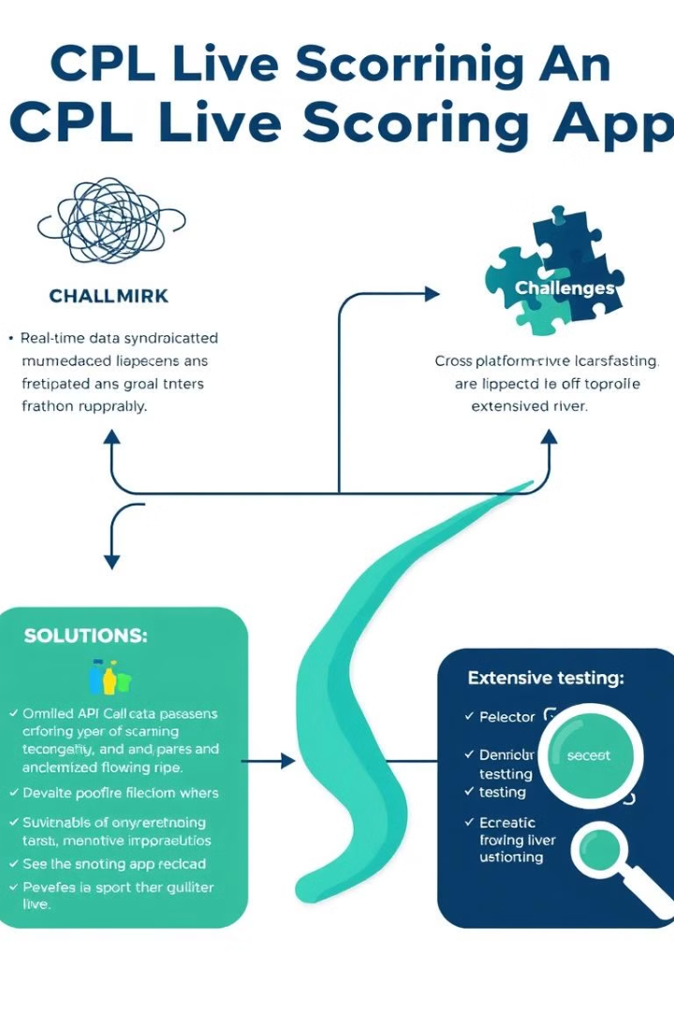


Challenges and Solutions: Overcoming Technical Hurdles
Real-Time Data Synchronization
Maintaining consistent data updates across platforms posed a challenge, which was addressed through optimized API calls, ensuring efficient data transfer.
Cross-Platform Compatibility
Ensuring a uniform UI/UX across various devices was a key concern, addressed through thorough testing on both Android and iOS platforms.

Slide 9
Conclusion
The CPL Score Management and Live Score Sharing Application demonstrates a successful integration of cross-platform tools to deliver a high-quality user experience. The system meets all primary objectives and is positioned for future growth with potential feature enhancements and scalability.

